Slide 1
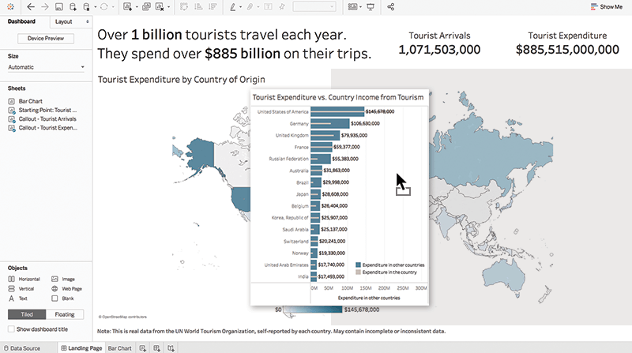
Introduction to Tableau
Road to a visualization Jedi
datatipsy

Slide 2


Slide 3



Slide 4
Introduction to Tableau
Road to a visualization Jedi
datatipsy

Slide 5
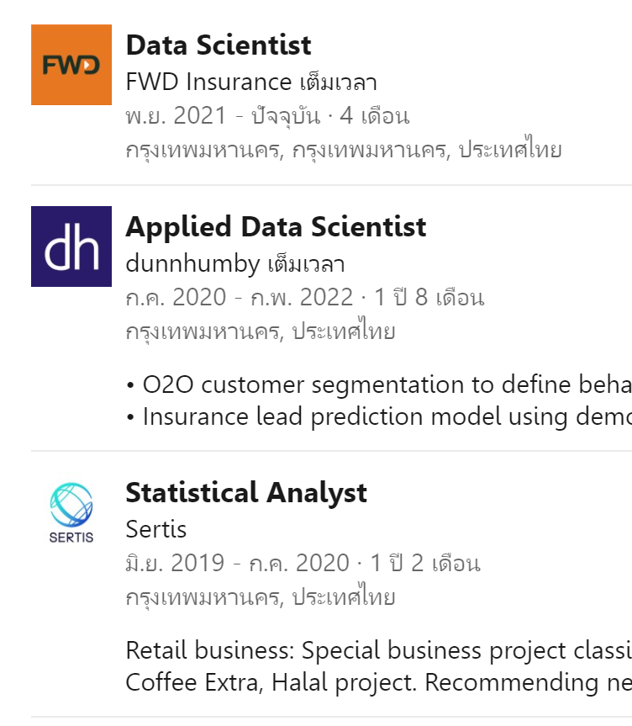
Hi, I’m Park. Nice to meet you all!
Experience

Slide 6


Slide 7
Agenda
Why Business Intelligence? Why Tableau? - Traditional vs BI way - Tableau and its capability
Building a BI Project - The 3 steps to build a dashboard to serve business users
Let’s get started with Tableau - Get start: Download Material, Resource & Data explanation - Your first chart: Connecting to Data, Navigate Tableau,Export worksheet - Joining, Blending & Relationships + KPI chart - Time series, Map, Scatter plot & Sorting - Dashboards & Storytelling

Slide 8
Why Business Intelligence?
Why Tableau?
A single source of truth and real-time analytics
datatipsy

Slide 9
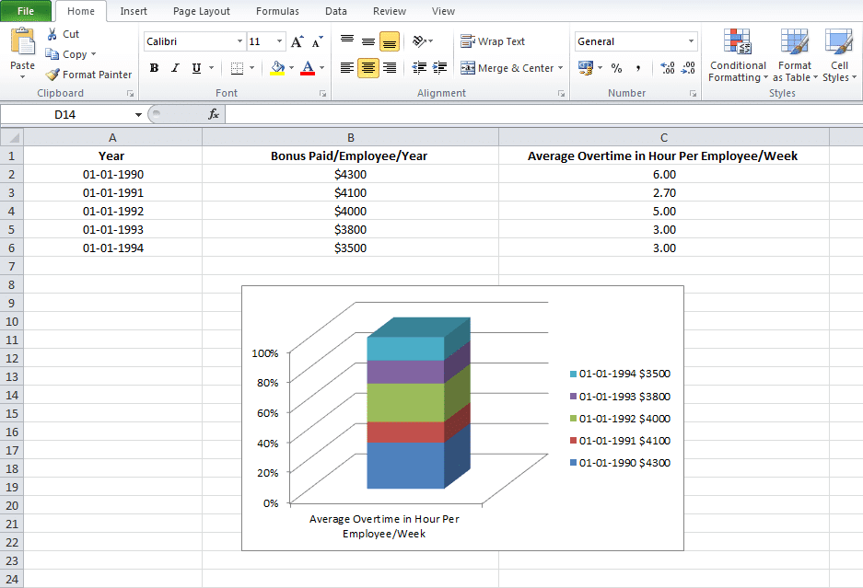
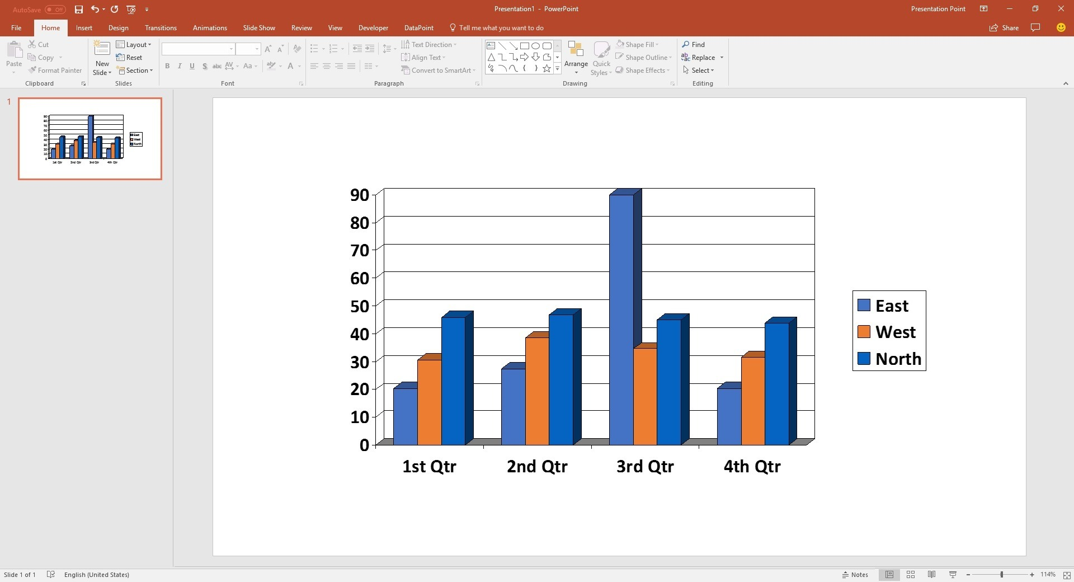
Traditional data presentation style are difficult to edit
and has limited perspectives
Compute in Excel
Display a chart in Power Points
What do you think are the pain points?

Slide 10


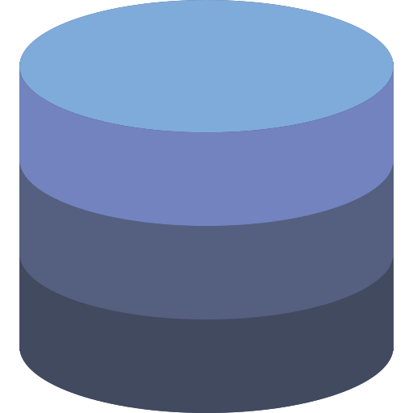


A Business Intelligence Tool connects directly to the database
and display a change in the data in real-time.
Query
CSV Upload
Dashboard
Serve
database
Users / Executives
Want to see multiple dimensions of the data, and want to see it now, not later.
Direct connect
Companies keep raw data in the database,
not a spreadsheet.

Slide 11
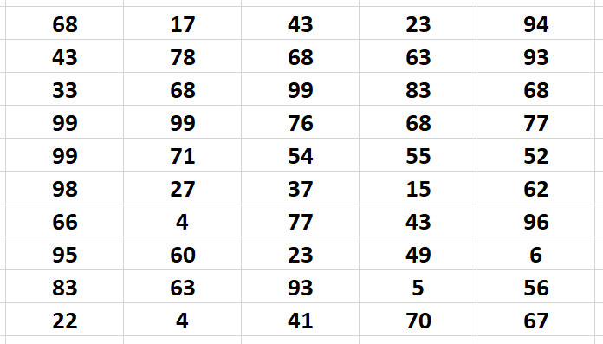
Why Tableau?
User friendly BI tools, just drag & drop, No coding
Via Tableau you can get faster, easier, scalable Visualization
Our human eyes are faster with colors and pattern than table format
Need proof ??

Slide 12
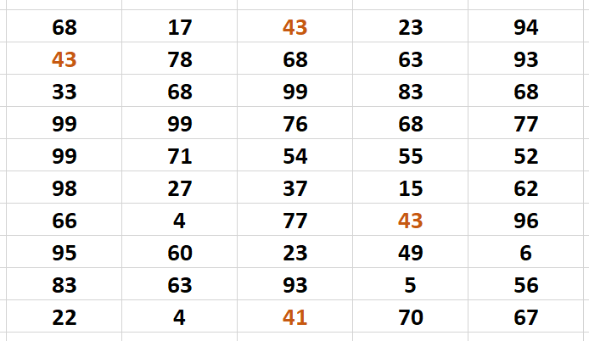
Why Tableau?
User friendly BI tools, just drag & drop, No coding
Via Tableau you can get faster, easier, scalable Visualization
Our human eyes are faster with colors and pattern than table format

Slide 13
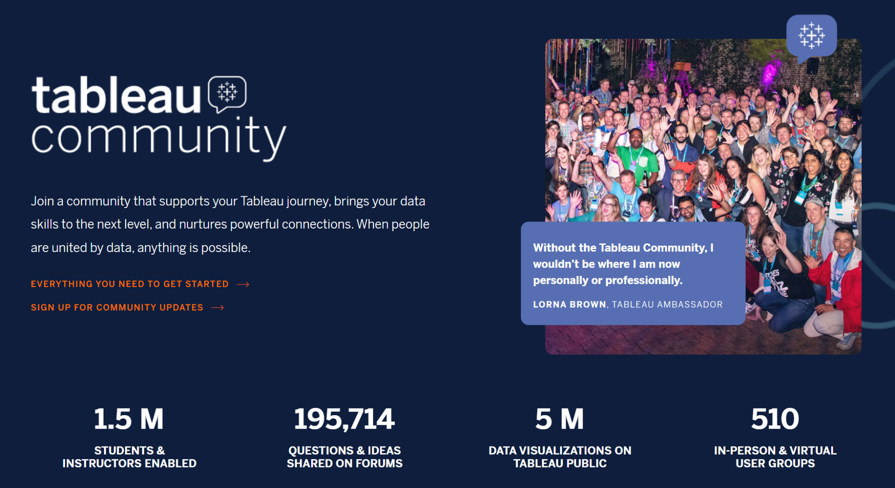
Why Tableau?
Able to connect to almost every Data source type
Hugh community (you can think of stack overflow of Tableau)

Slide 14

Why Tableau?
ผาแต้ม อุบลราชธานี

Slide 15

Why Tableau?
Napoleon March Map

Slide 16
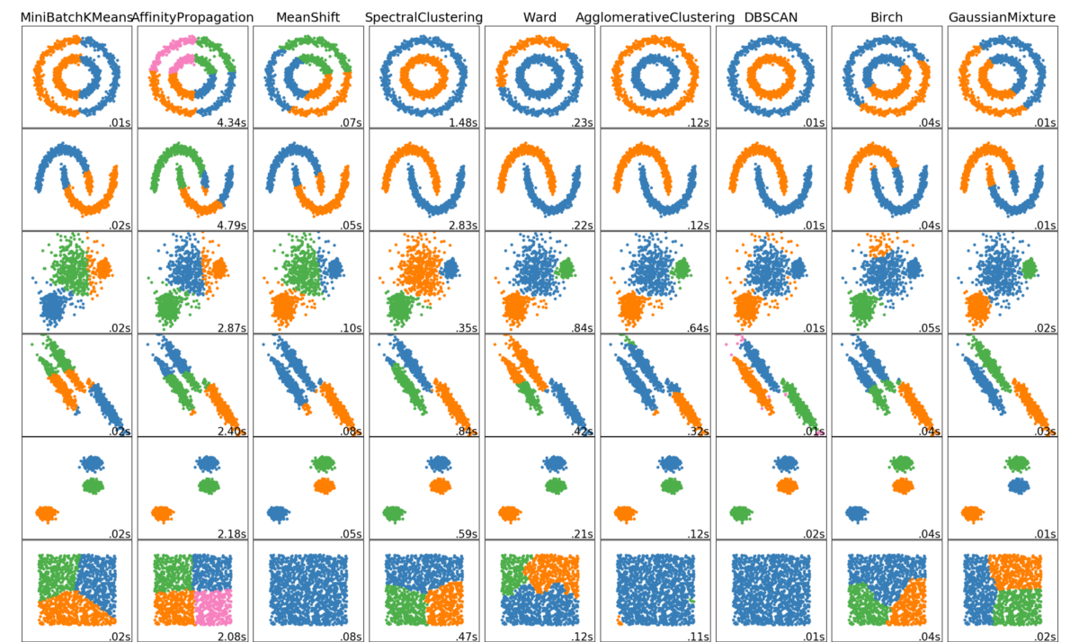
Who needs Tableau?
BI developer
BI consultant
Tableau consultant
Data analyst
Data scientist
All professionals in data driven companies

Slide 17
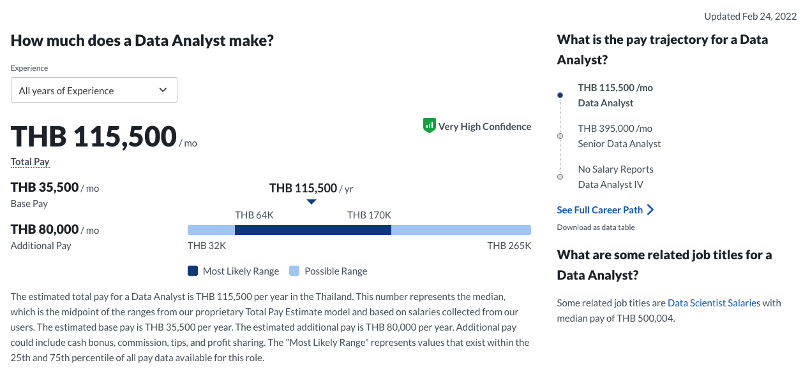
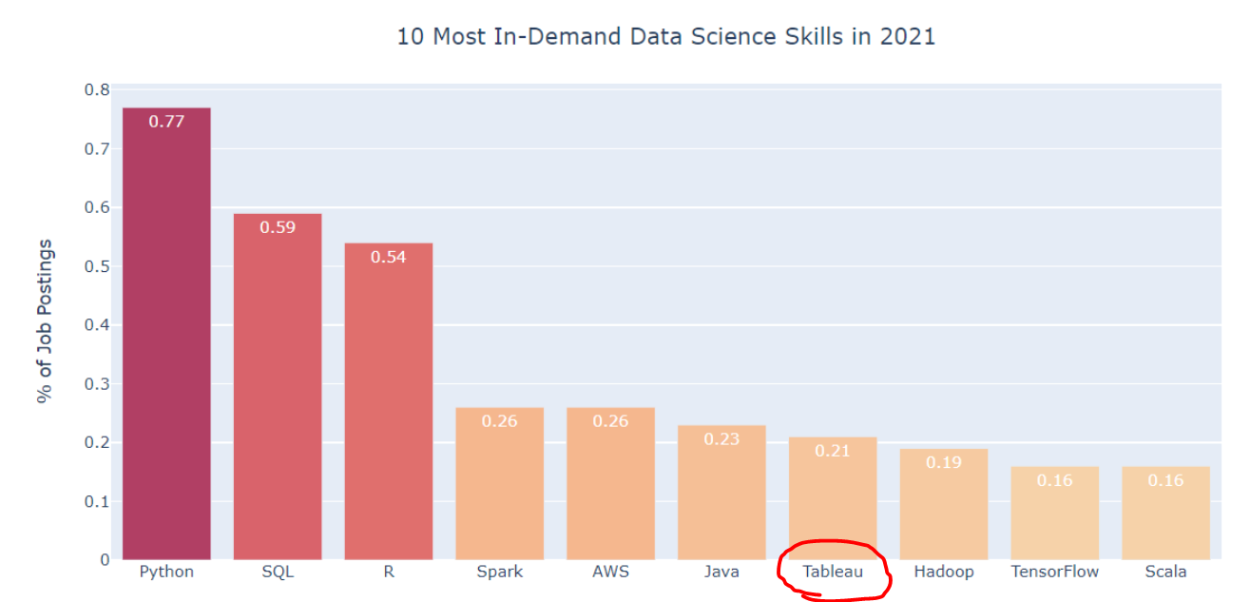
Tableau is a road to Data Analyst, a highly in demand skill.
A reference for
career starter
30K - 60K

Slide 18
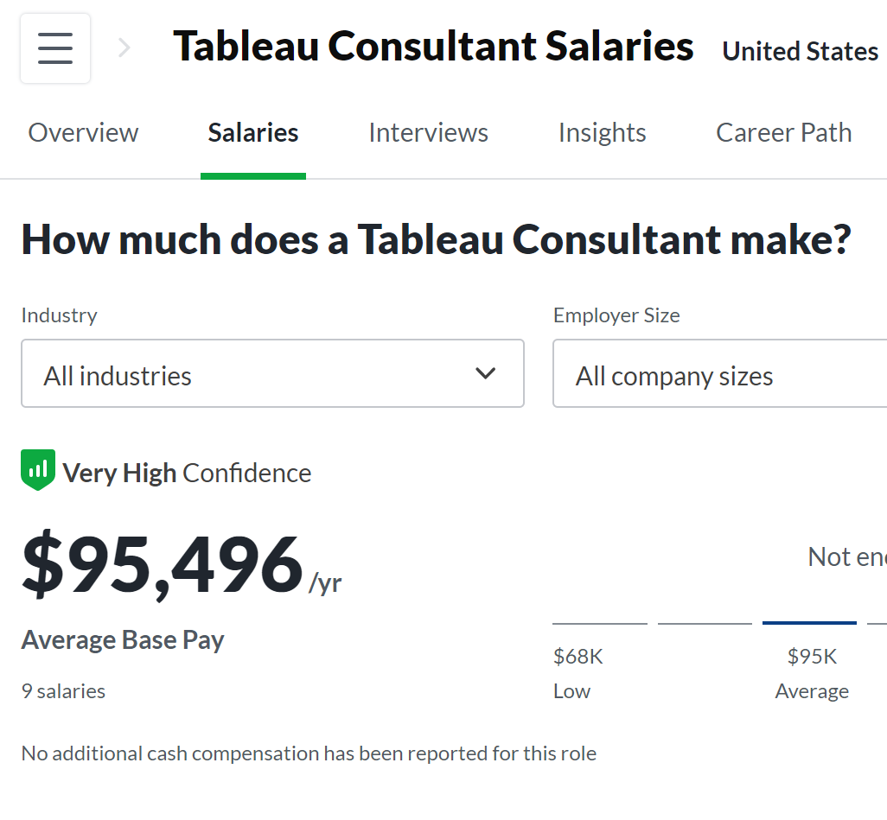
Tableau is a road to Data Analyst, a highly in demand skill.
Tableau also lists as LinkedIn
Top 10 Skills in-demand for Data Jobs

Slide 19
Building a BI Project
start with a questions, build charts that are easy to understand
datatipsy

Slide 20
Step 1: Start with users, questions, hypothesis, and objectives
Executives
“How is our sales this Quarter compared to last year?
Where are the differences from? What products generate the highest sales organically?
We may need to push that product this year”
Marketing Team
“Do we know how many of product A are in the stock?
If it is less than X units, we may need to inform the marketing team to wait before launching a new campaign”
Sales Team
“Our sales is declining this month. I guess it’s because of product B. How many percent was the decline? We may need to cover that up with other products.”

Slide 21
Step 2: Design the experience, and verify with users
Executives
“How is our sales this Quarter compared to last year?
Where are the differences from? What products generate the highest sales organically?
We may need to push that product this year”
Year A
Year B
2022
2020
2022
Year A
2021
Year B
Q1
Q2
Q3
Q4
Q1
Q2
Q3
Q4

Slide 22

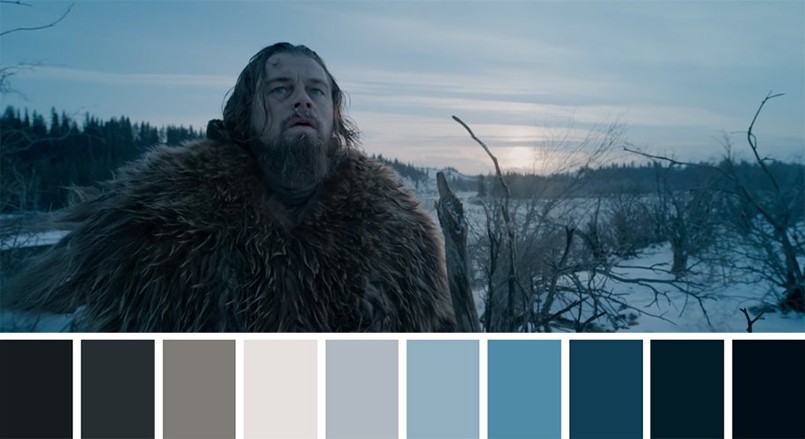
Step 3: Make it beautiful, and right.
Choosing the consistent themes and colors
For business, use company colors, or project themes.
For personal use, follow your color design skill, or go to a color palette generator website

Slide 23
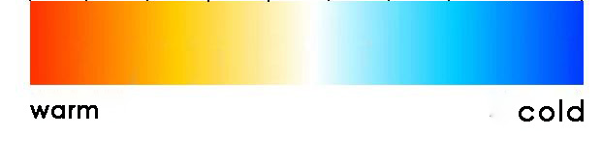
Choosing the meaningful colors
7%
main
benchmark
-5%

Slide 24
Select appropriate charts
Line Chart: Visualizing trends over time
Bar Chart: Comparing across categories
2022
2021
Q1
Q2
Q3
Q4
Line can be used to compared across categorical data as well, but it implies a sequence.
Be careful of having too many benchmarks (years, in this case). You may need to apply parameters.

Slide 25
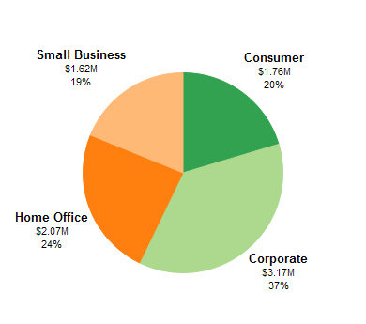
Select appropriate charts
Pie Chart: Visualizing trends over time
Bar chart with percentage contribution.
120 M
90 M
67%
67%
23%
23%
10%
10%
Don’t use Pie chart if you have too many categories.
You can combine all the small categories into one and call it “others”, or use other charts.
Similar to pie chart but you can compare across different bars

Slide 26
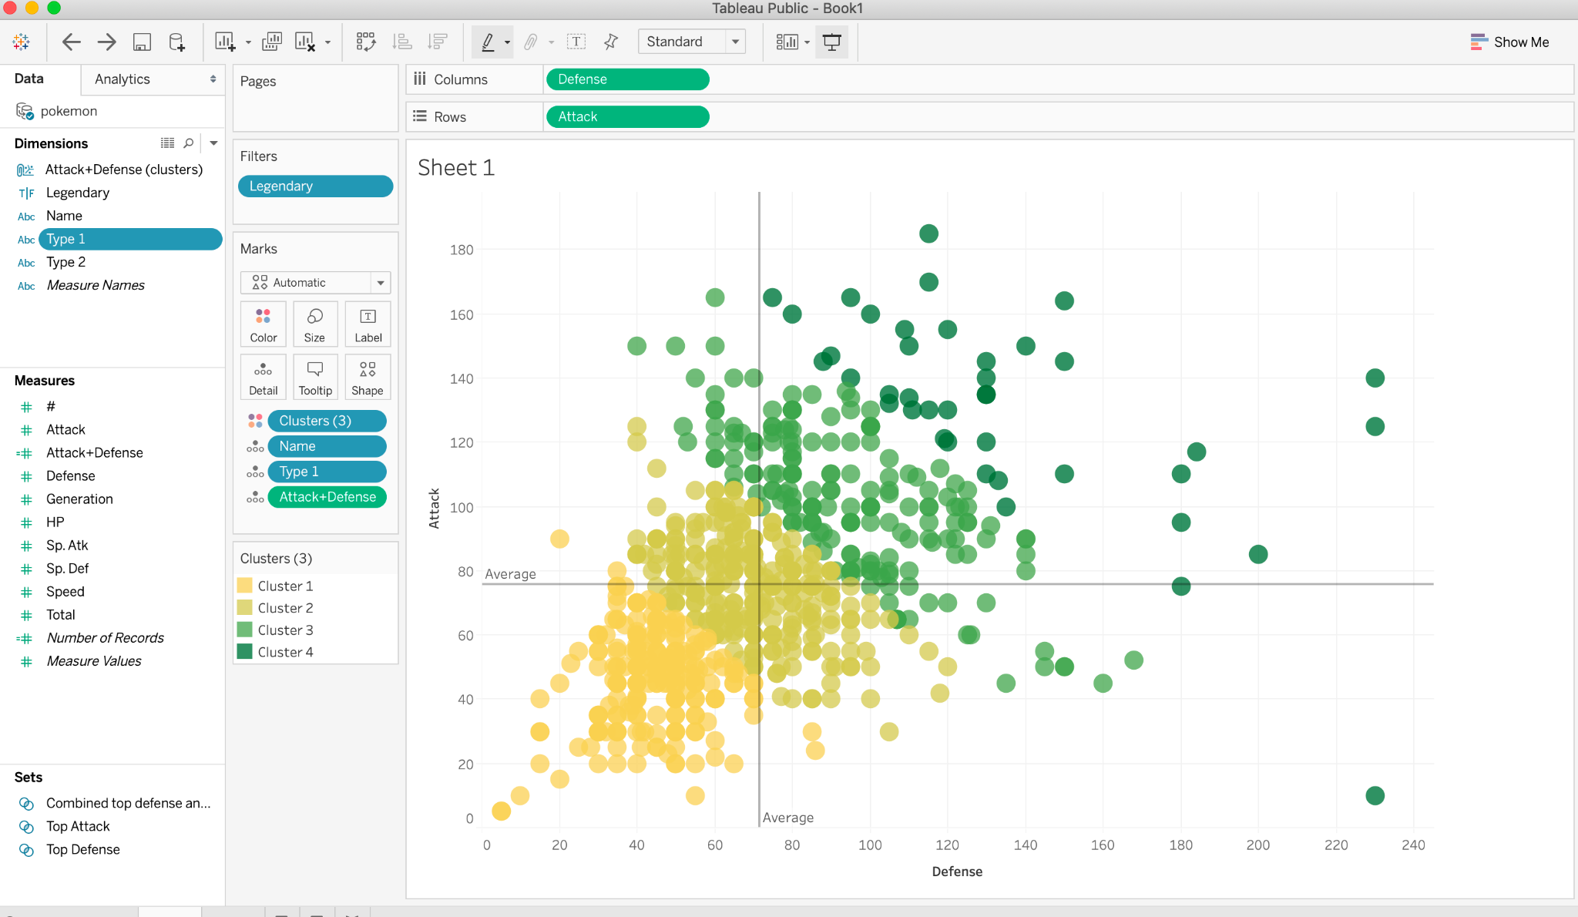
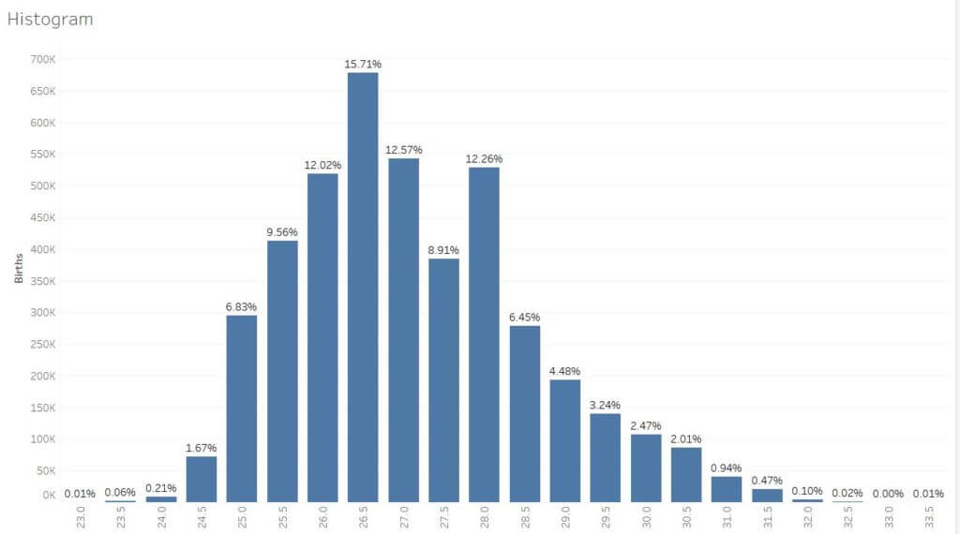
Select appropriate charts
Scatter plot: investigating relationships, build segmentation
Scatter plot: Observe a distribution over one dimension
Also handle outliers, and understand that this is one dimensional point of view.
Make sure you handle to outlier to make your chart visible.

Slide 27
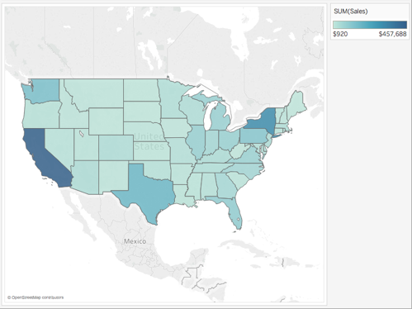
Select appropriate charts
Map:

Slide 28
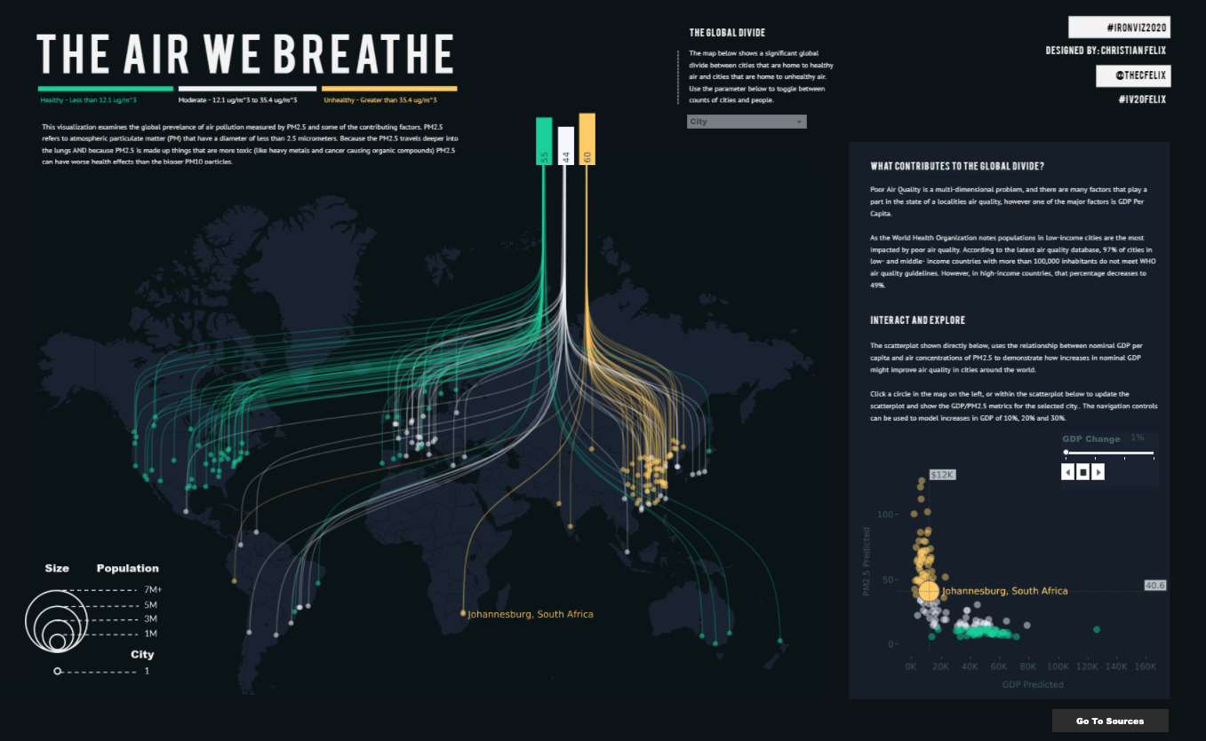

Slide 29
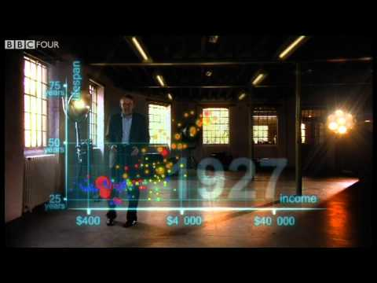

Slide 30
Let’s get started with Tableau
Building your first charts
datatipsy

Slide 31
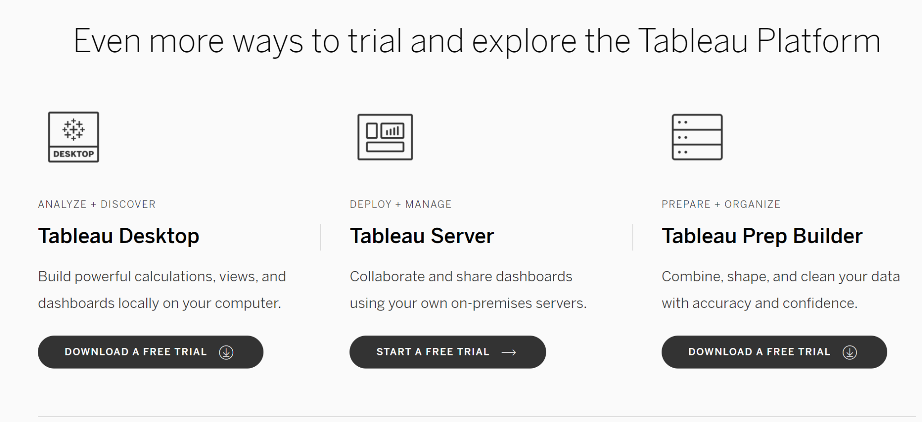
Let’s get started : Install Tableau Desktop
Link: https://www.tableau.com/products/trial

Slide 32
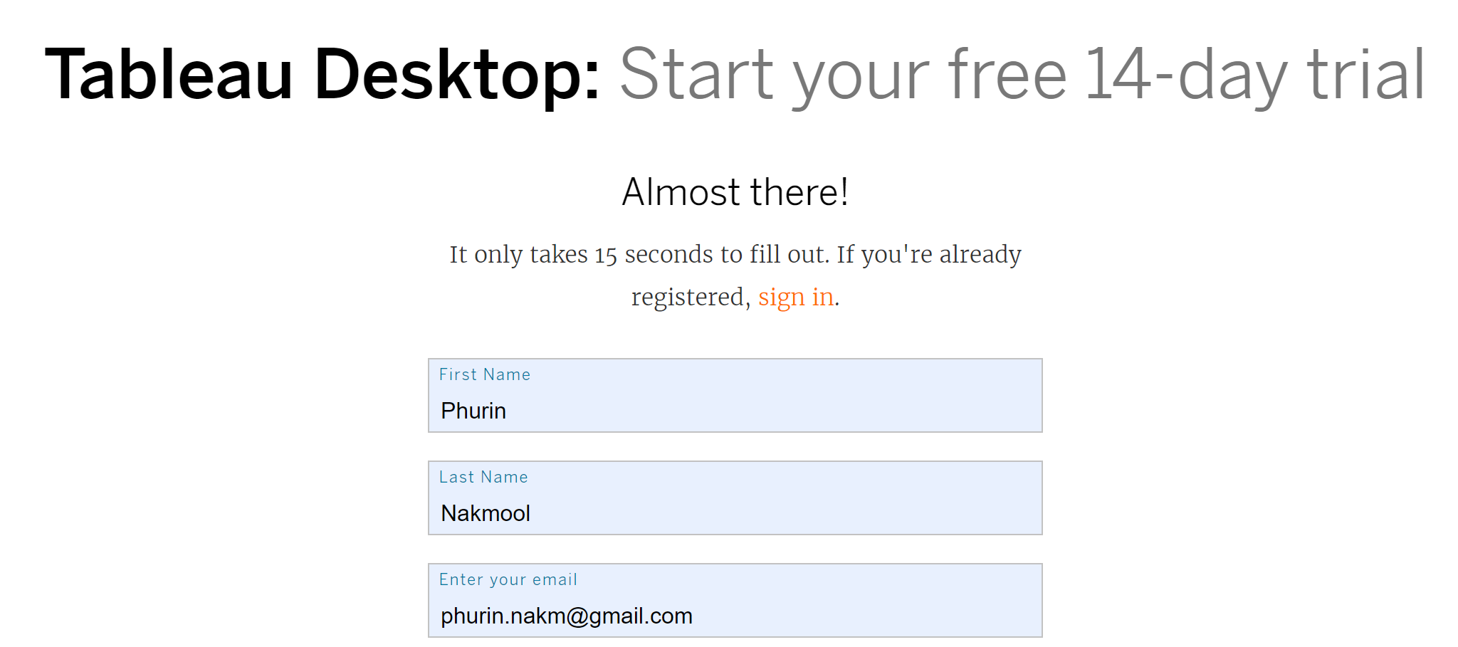
Let’s get started : Install Tableau Desktop

Slide 33
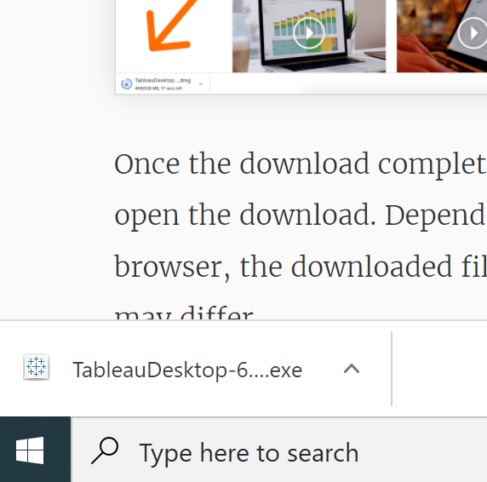
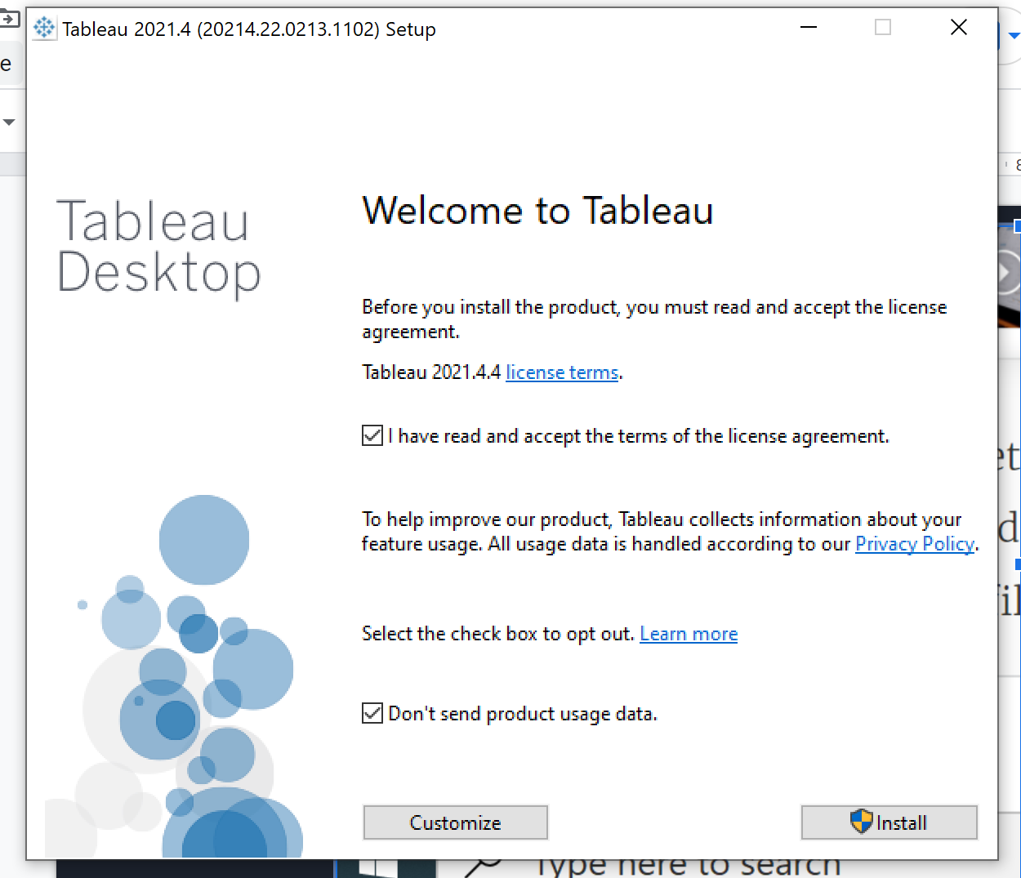
Let’s get started : Install Tableau Desktop
After installation, Fill out Trial Registration form to get start

Slide 34
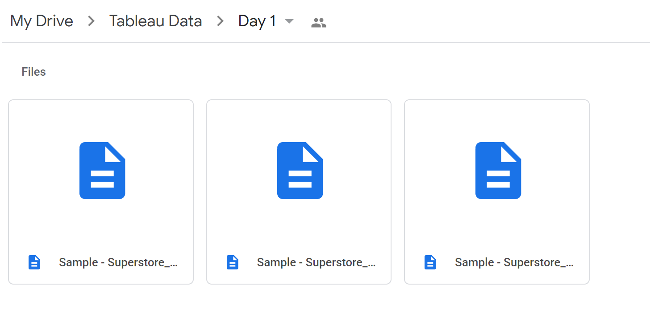
Let’s get started : Super store data
Download Data set :
Super store Orders
Super store People
Super store Returns

Slide 35
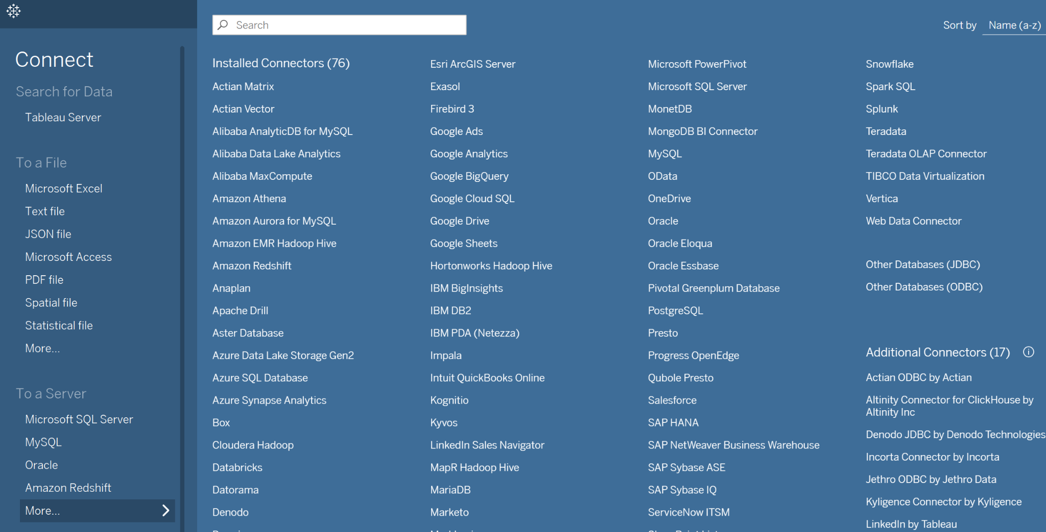
Your first chart: Connecting to Data

Slide 36
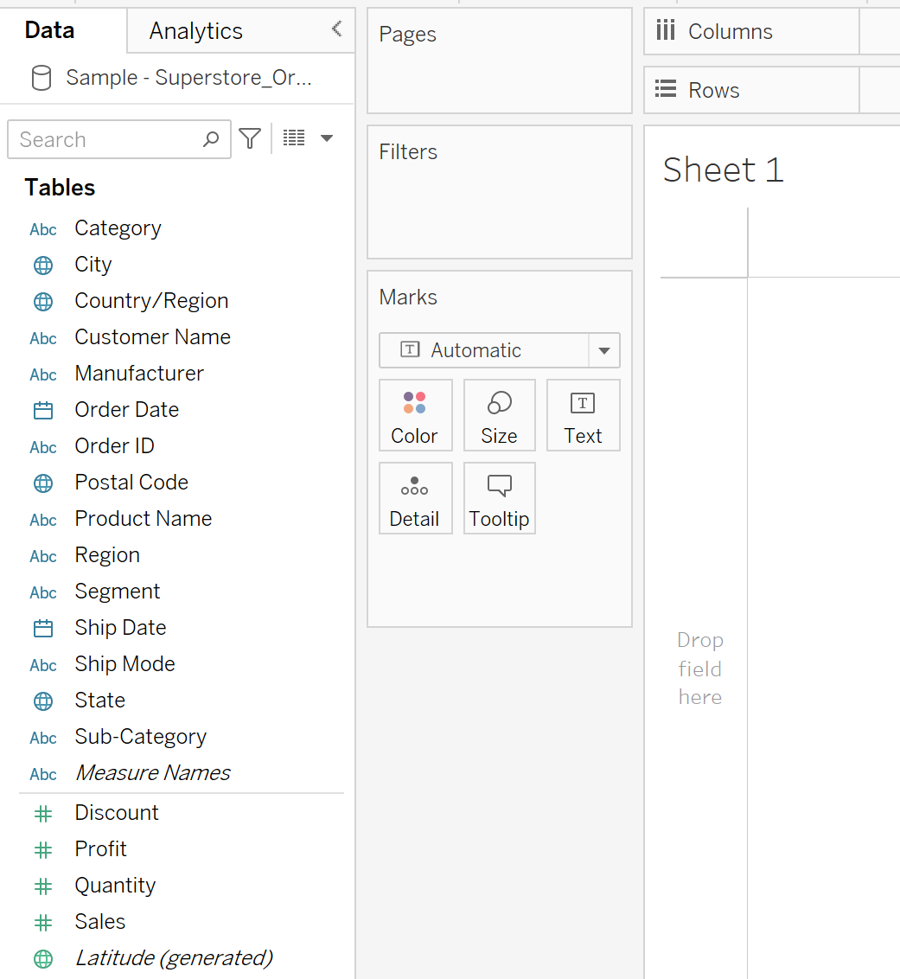
Your first chart: Navigate Tableau
Data pane
Columns & Rows
Filters
Marks

Slide 37
Your first chart: Get familiar and just try it!
Try dragging something from datapane to Columns & Rows
Basic barchart
Calculate field
Adding colors
Adding Labels & Format
Exporting your worksheet

Slide 38
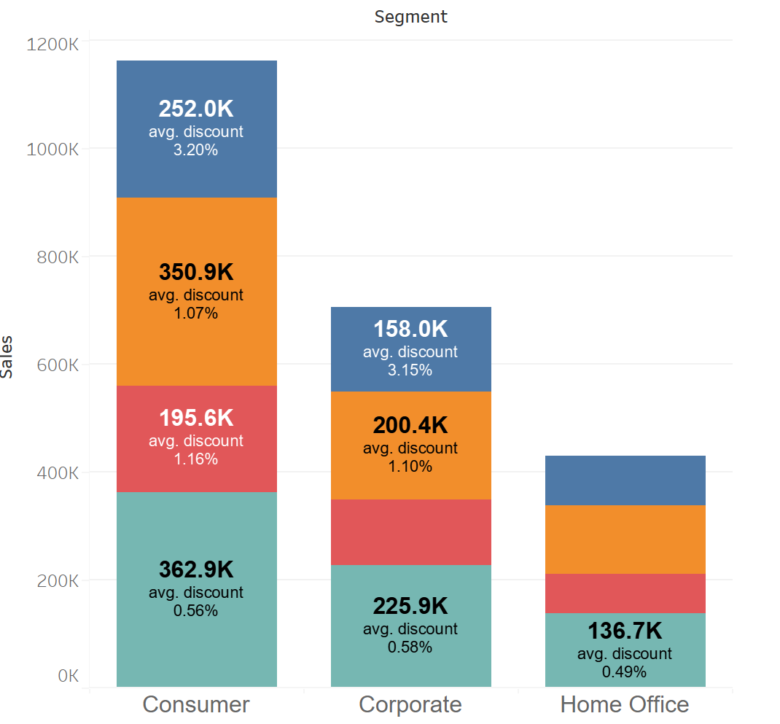
Your first chart: Get familiar and just try it!

Slide 39
Your first chart: 7 minutes problem
Create bar chart
Separated bar of Total Cost by Region
Fill color by Category
Label with Average cost per unit
Export Image
Hint: Cost = ? - ?

Slide 40
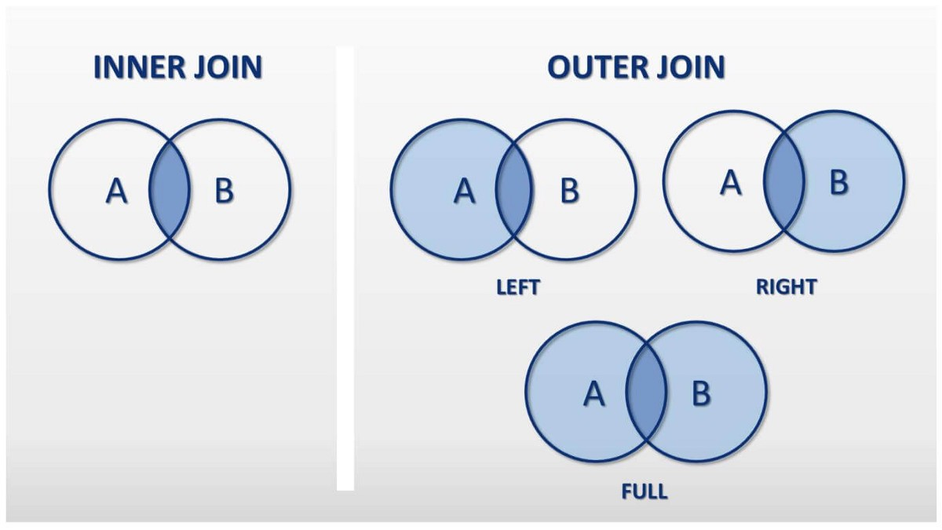
Joining, Relationships & Dual Axis

Slide 41
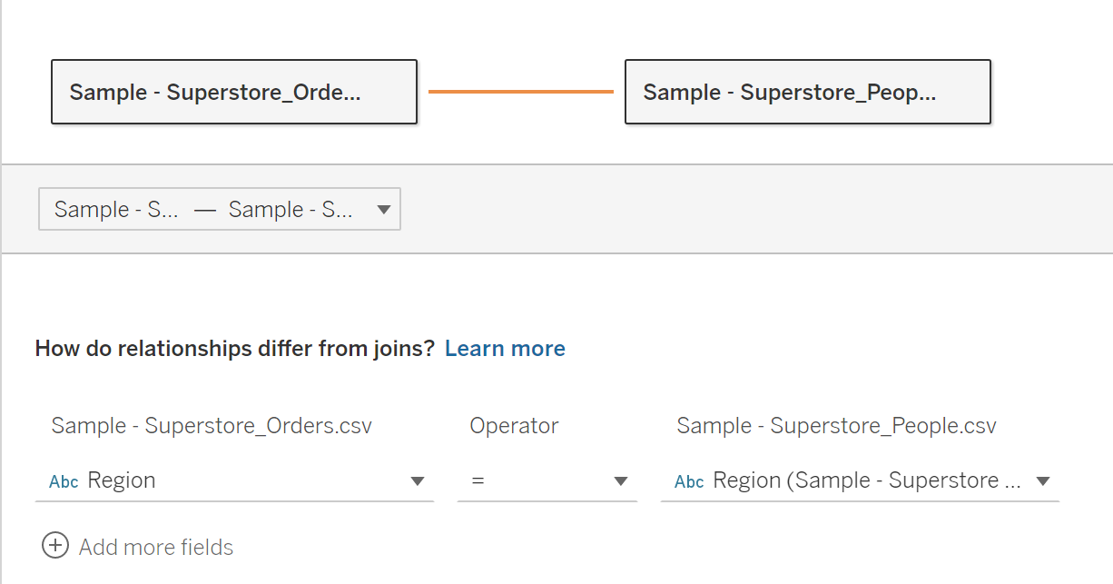
Joining, Relationships & Dual Axis

Slide 42
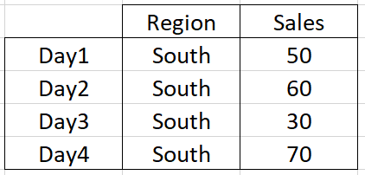
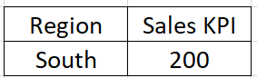
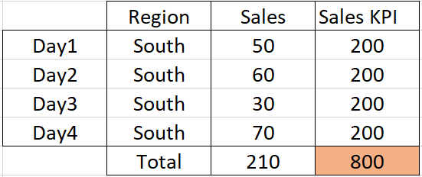
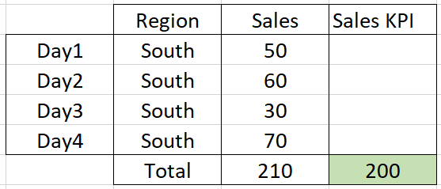
Joining vs Relationships
Left Join with Region
Relationship on Region

Slide 43
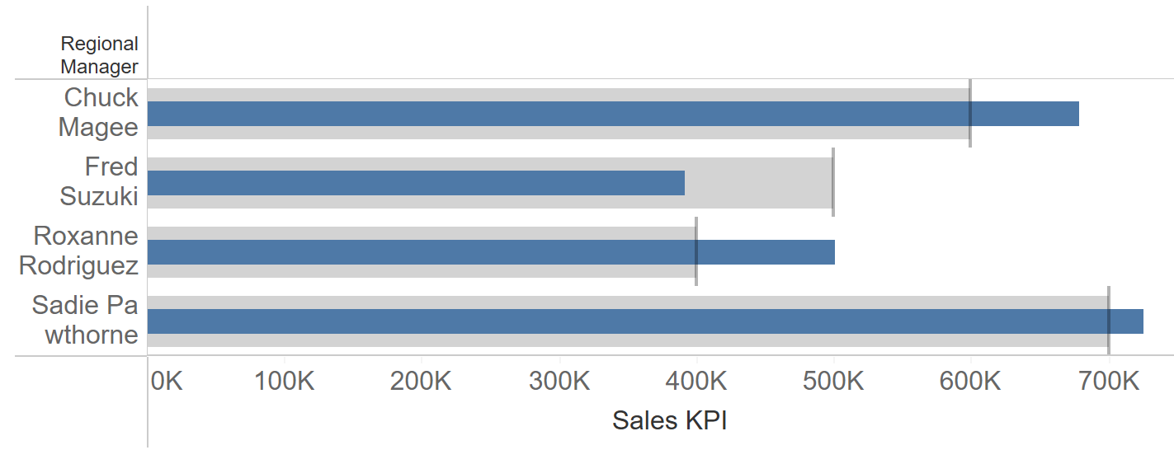
Joining, Relationships & Dual Axis
Create KPI Charts:
***Who can pass KPI with only sales from Consumer & Corporate Segment? (1 min)

Slide 44
Joining, Relationships & Dual Axis
Your KPI Charts in 10 minutes
%Margin KPI chart
Find Who pass or Fail?
Color the graph: Pass Green, Fail Red
%Margin = Total Profit / Total Sales

Slide 45
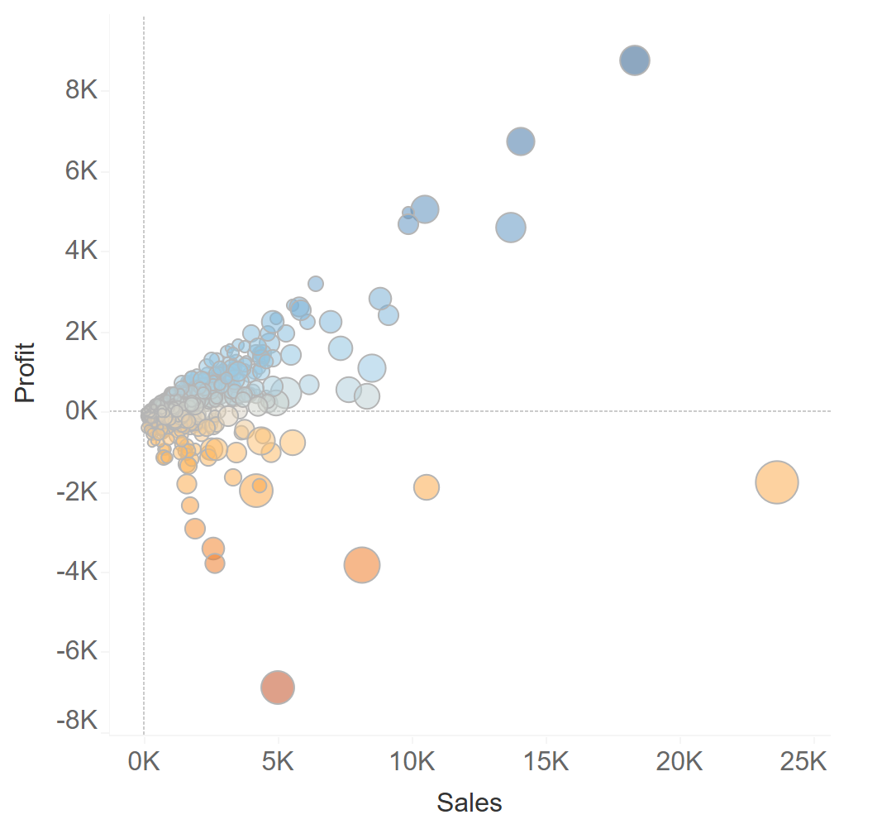
Scatter plot, Time series, Map & Sorting
Is there a relation between Profit & Sales? What’s about Sales & Quantity? (2 min)

Slide 46
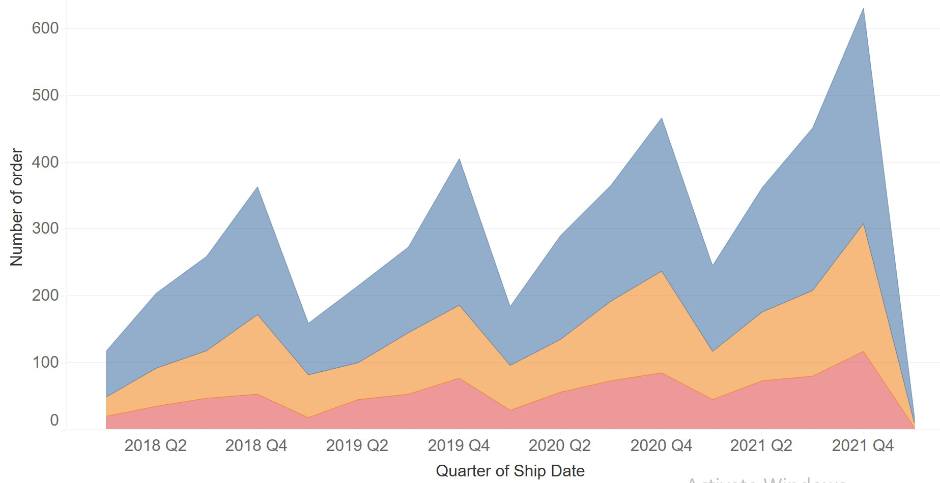
Scatter plot, Time series, Map & Sorting
Is there still a seasonality in monthly level? Which region has the strongest seasonality? (1 min)

Slide 47
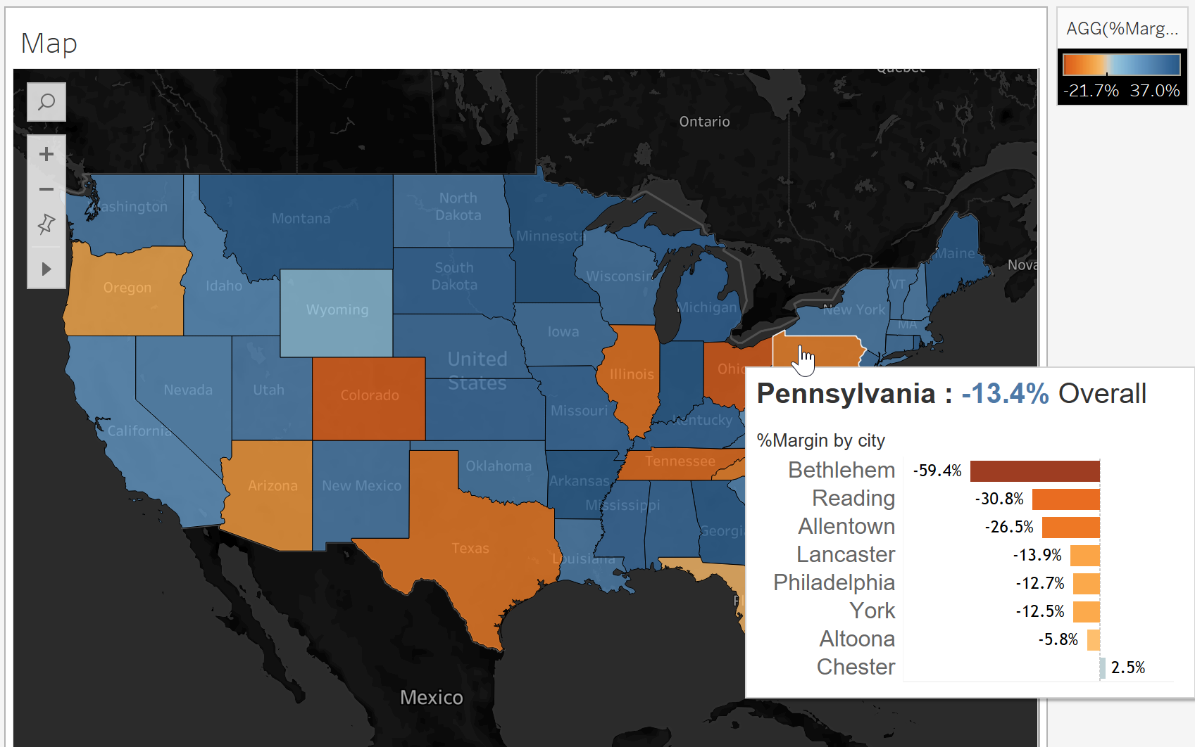
Scatter plot, Time series, Map & Sorting

Slide 48
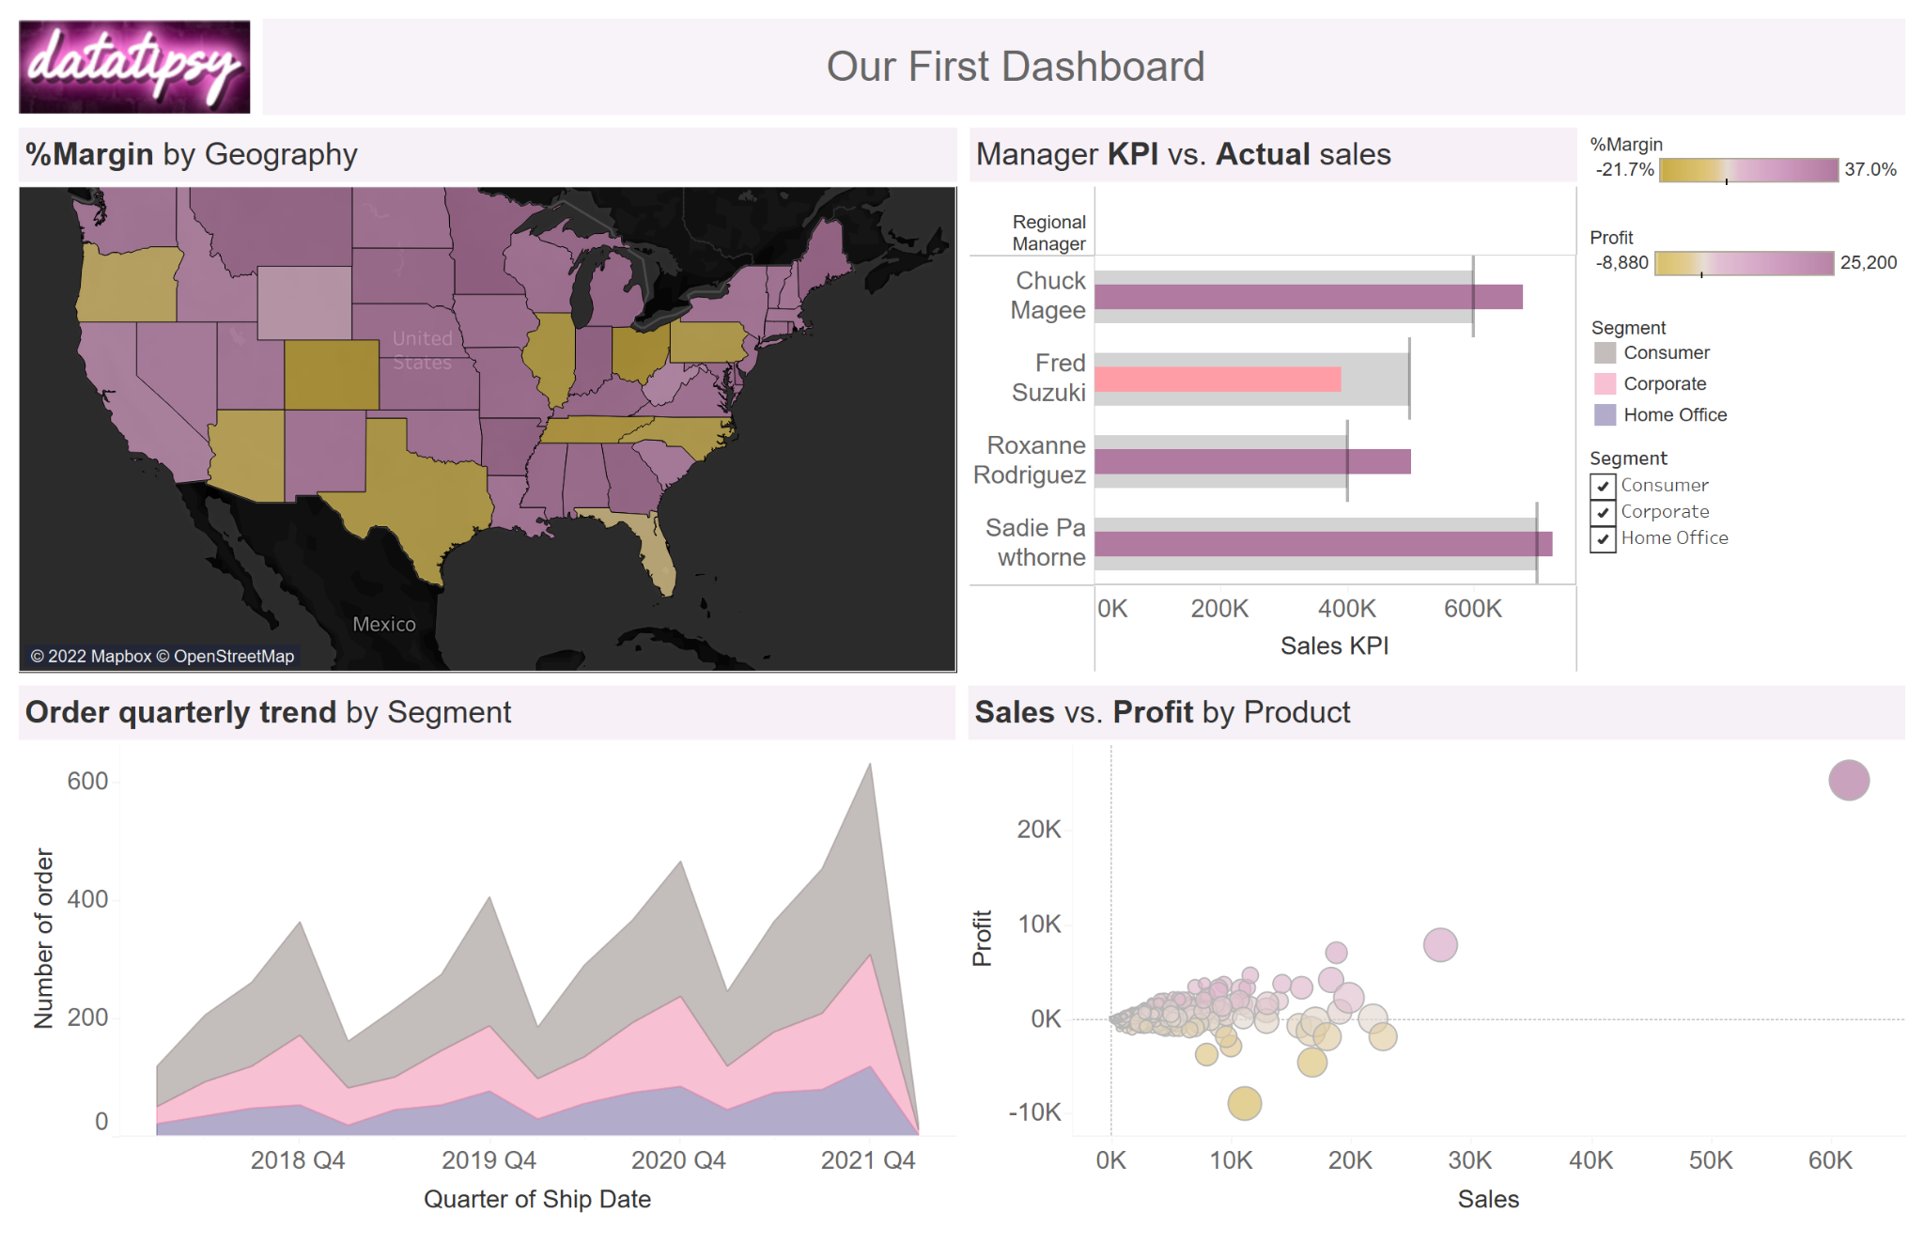
Dashboard & Storytelling

Slide 49
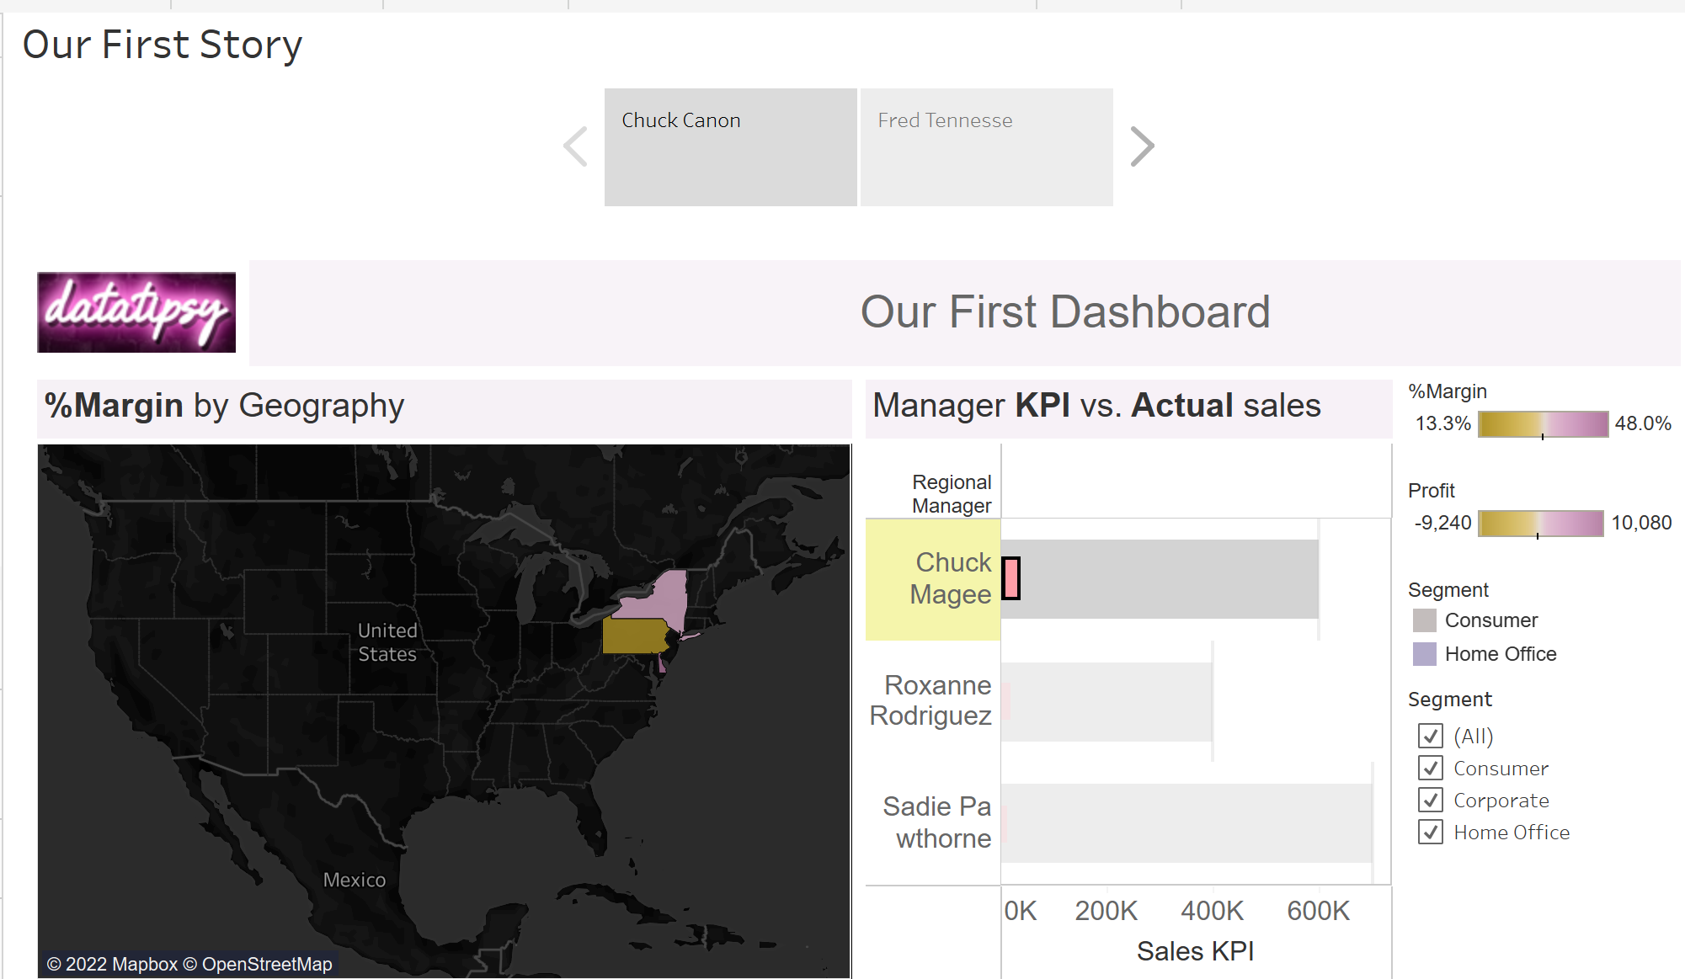
Dashboard & Storytelling

Slide 50

Dashboard & Storytelling
Recommended Book for story telling

